Slide 1
How to Be an Even Better Parish Church
Learning to share Jesus with spiritually curious neighbors

Slide 2
Session 1: What and Why?

Slide 3
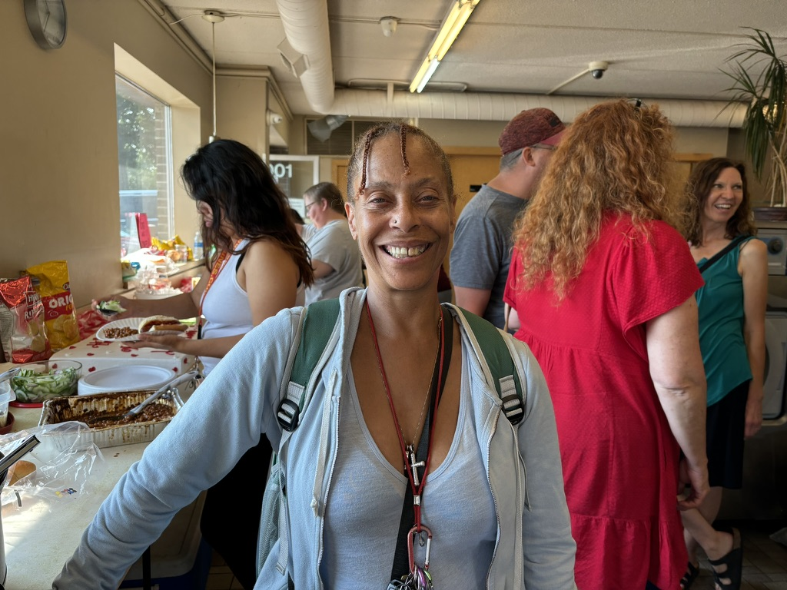
What are New Christian Communities?
New - mainly with people who don’t attend church
Christian - focus on Christ
Community - meet at least
monthly
Laundry Love, Team From St. John’s, St. Cloud

Slide 4
Why?
Shobi’s table food truck ministry: Kristen & Jeff Kidder, Martha Olive & Myra Arnold (Messiah, St. Paul)

Slide 5
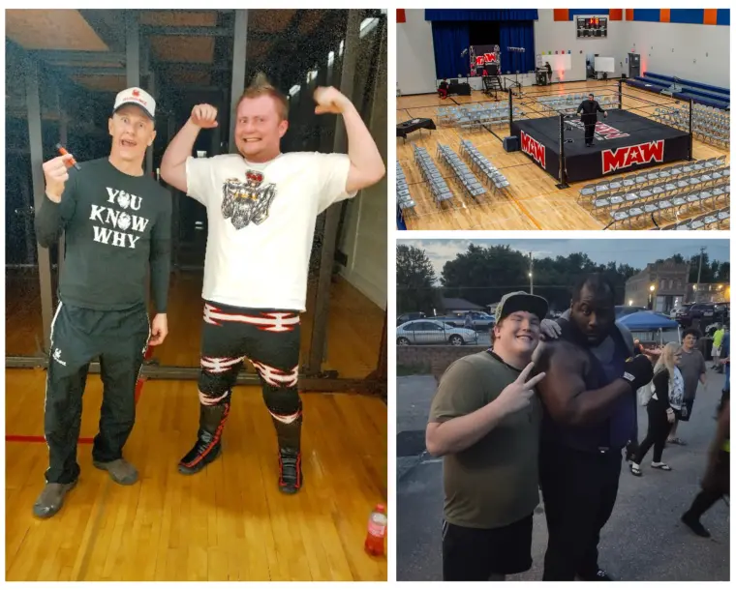
Why?
Missional
Ministry to professional
wrestlers, Nick and Jayne Kinney (St. Martin’s, Minnetonka Beach)

Slide 6
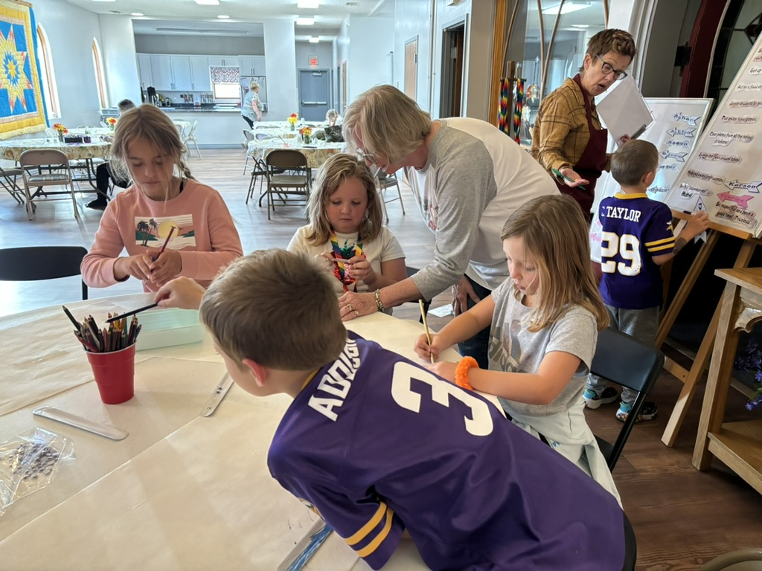
Why?
Missional
Contextual
A Place at the Table community dinner & kid’s program, Pat Dee and Pat Dibble, St. Peter’s, Kasson

Slide 7
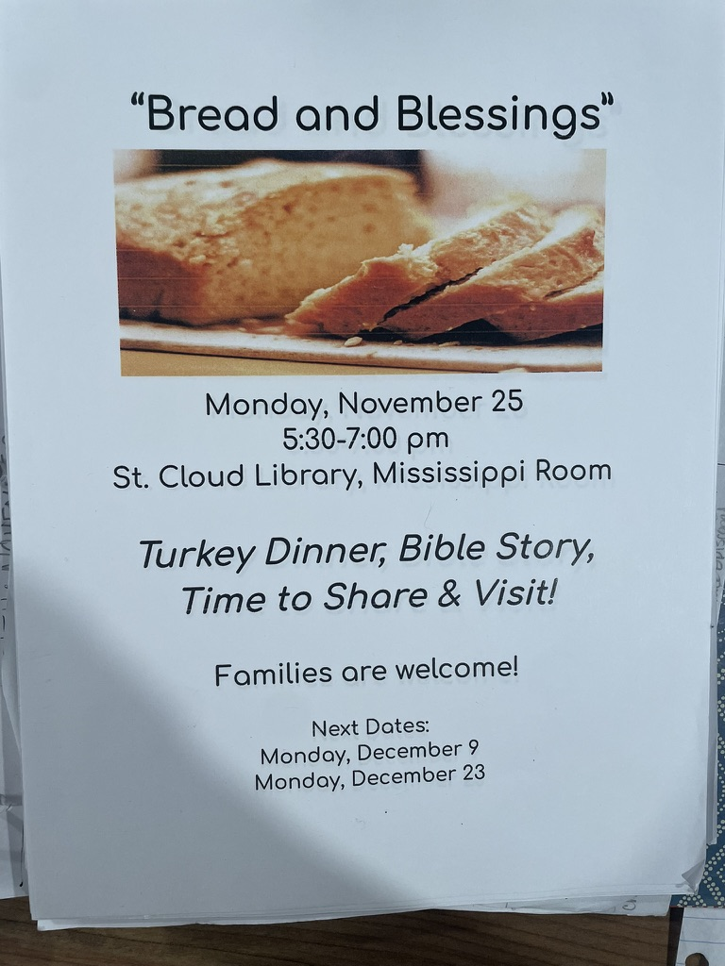
Why?
Missional
Contextual
Formational
The next faithful step for
spiritually curious Laundry Love participants & leader Nancy Dyson (St. John’s, St. Cloud)

Slide 8
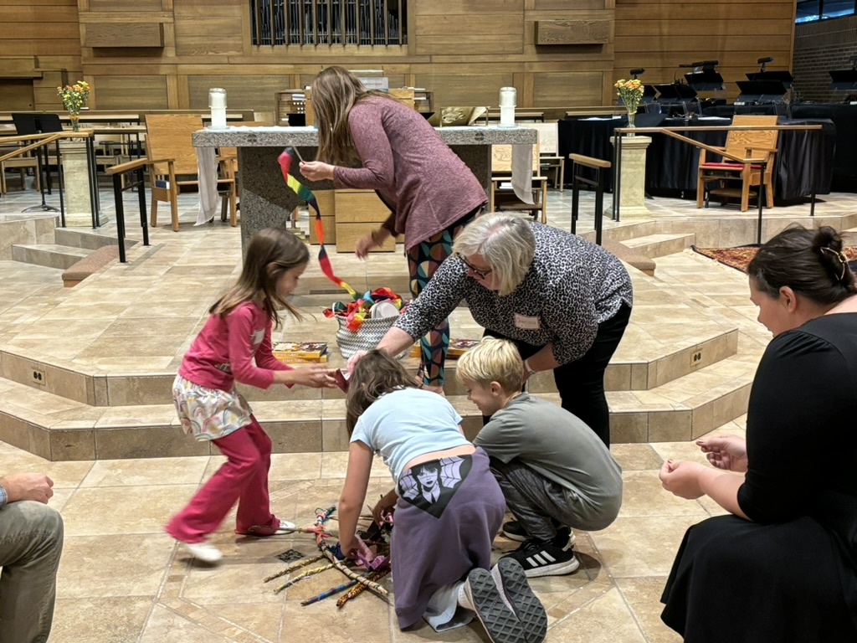
Why?
Missional
Contextual
Formational
Ecclesial
Messy Church, Trinity, Excelsior, Sally Hockinson and Team

Slide 9
Why - Theology
Missional - Mission of God
Contextual - The Incarnation
Formational - Great Commission
Ecclesial - Church

Slide 10
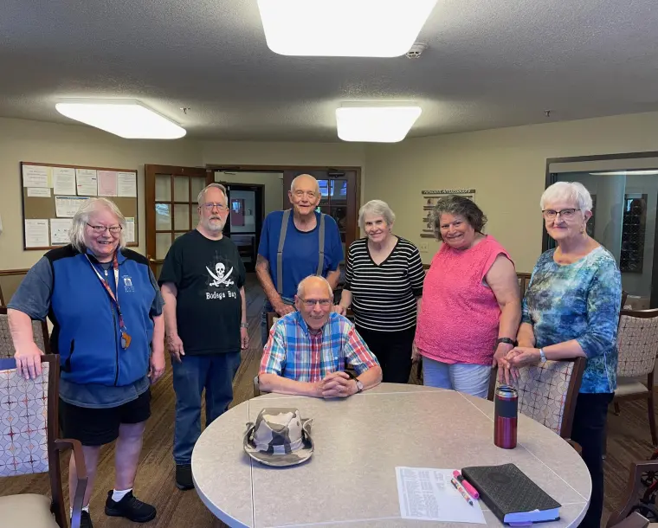
Session 2: How?
Senior living prayer group,
Dick Guiton (Messiah, St. Paul)

Slide 11
Recap
What are New Christian Communities?
New - mainly with people who don’t attend church
Christian - focus on Christ
Community - meet at least monthly
What theology are they based on?
Missional
Contextual
Formational
Ecclesial

Slide 12
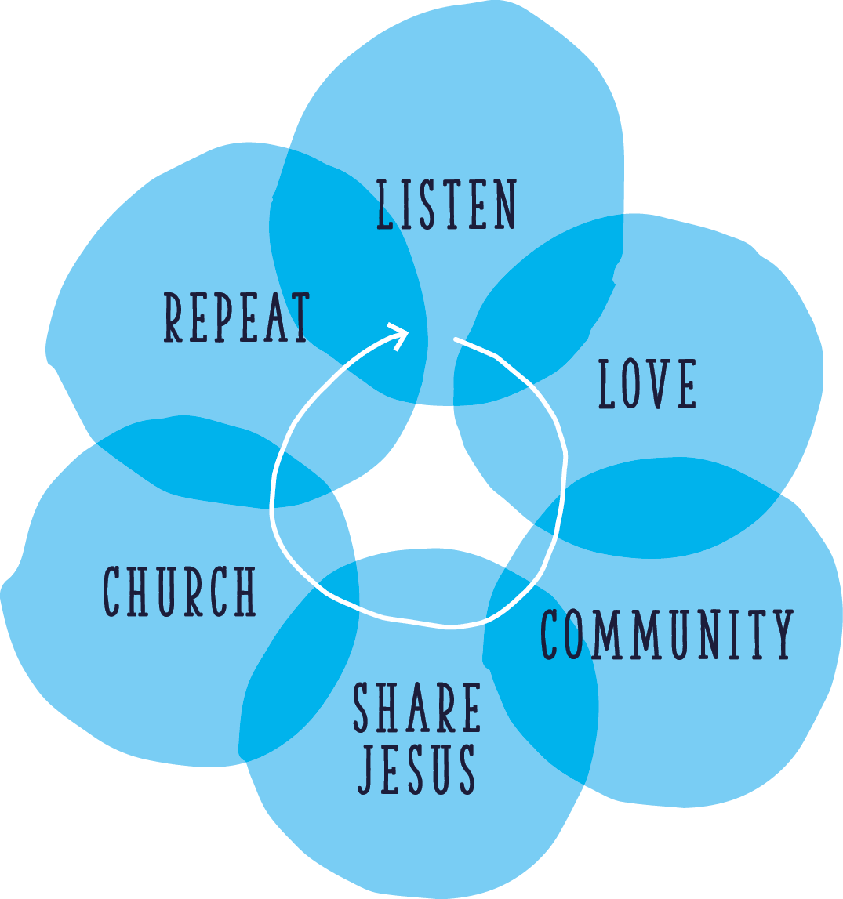
A Missional Journey

Slide 13
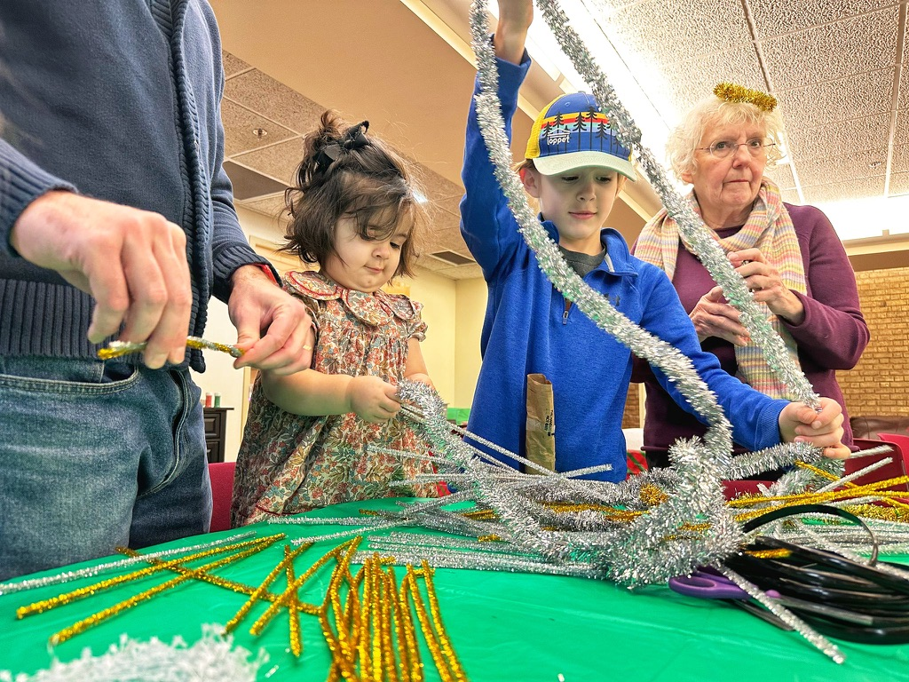
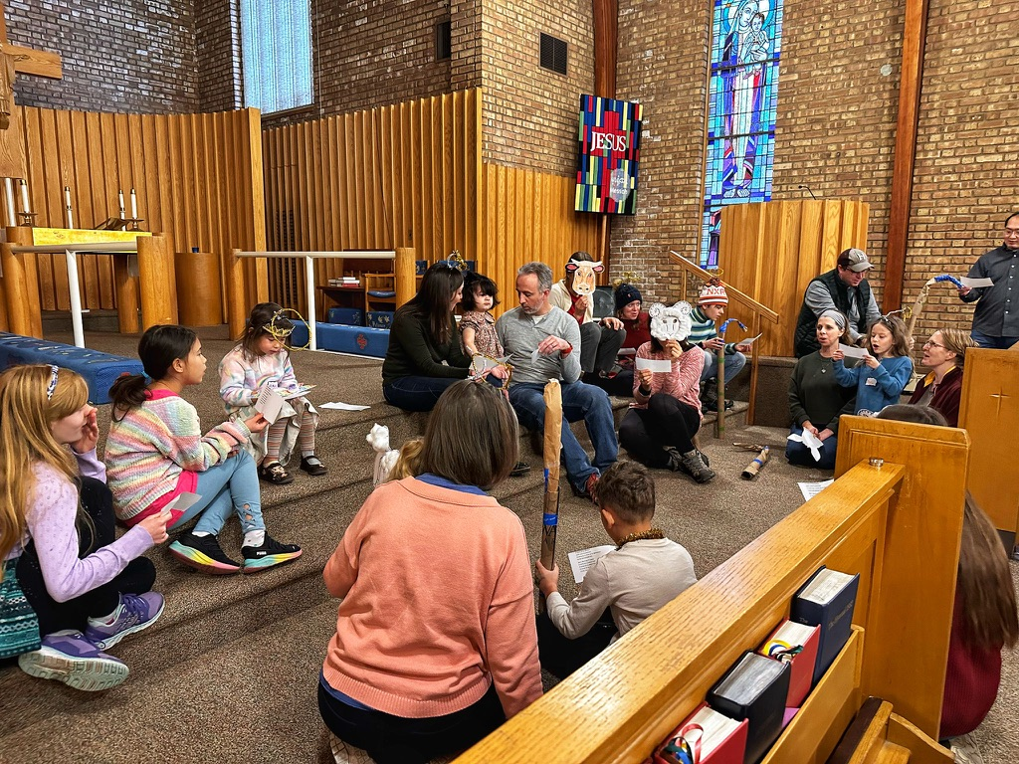
Session 3: Sharing Jesus
Messy Church, Messiah St. Paul, Jennifer Asp and Team

Slide 14
Recap
What are New Christian Communities?
New - mainly with people who don’t attend church
Christian – focus on Christ
Community - meet at least monthly
What theology are they based on?
Missional
Contextual
Formational
Ecclesial
How? Through the missional journey

Slide 15
A Pathway to Sacramental Worship
Step 1. A taste of spirituality (10 mins):
Welcome
Candle + music
Bible
Spiritual headspace
Concluding prayer/poem

Slide 16
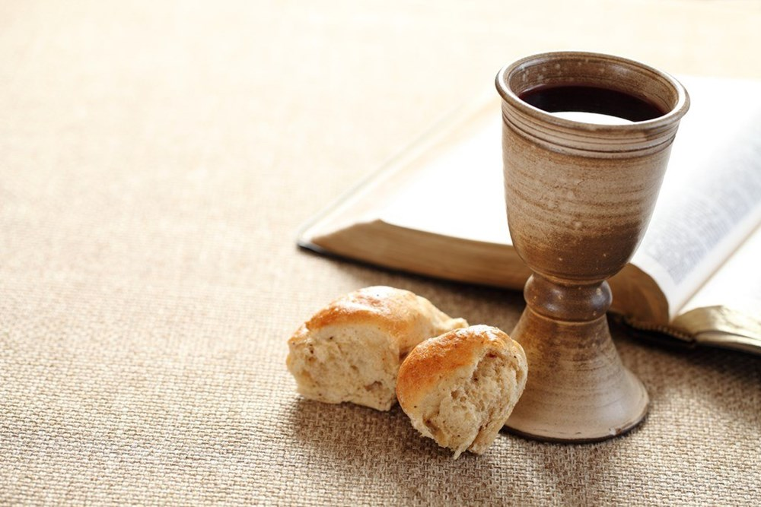
A Pathway to Sacramental Worship
Step 2. Simple Christian worship
Welcome (Gathering)
Candle + music (Worship in music)
Bible
Discussion (Sermon)
Spiritual headspace (Prayer)
Concluding prayer/poem (Blessing)

Slide 17
A Pathway to Sacramental Worship
Step 3. Service of the Word:
Gathering
Worship music
Confession
Reading
Discussion/sermon
Affirmation of Faith
Lord’s Prayer
Intercessions
Blessing

Slide 18
A Pathway to Sacramental Worship
Step 3. Eucharist
Gathering
Worship music
Confession
Reading
Discussion/sermon
Affirmation of faith
Lord’s Prayer
Intercessions
Eucharistic Prayer
Dismissal

Slide 19
A Pathway to Sacramental Worship
Step 1. A taste of spirituality
Step 2. Simple Christian worship
Step 3. Service of the word
Step 4. Eucharist
Website: cofe.io/soulspace

